Slide 1
Similitude and Dimensional Analysis
CE30460 - Fluid Mechanics
Diogo Bolster

Slide 2
Goals of Chapter
Apply Pi Theorem
Develop dimensionless variables for a given flow situation
Use dimensional variables in data analysis
Apply concepts of modeling and similitude

Slide 3
Basic Principles
Dimensional Homogeneity
In a system with several variables one can construct a series of numbers that do not have dimensions. This inherently tells you something about the scale invariance or lack thereof of a problem…..

Slide 4
Units and Dimensions Important in Fluids
Primary Dimensions
Length (L)
Time (T)
Mass (M)
Temperature (θ)
For any relationship A=B
Units (A)=Units (B) Dimensional Homogeneity
Notes:
In class example on the board

Slide 5
Simple Example
You are studying the pressure drop per unit length in a pipe
Variables: Δp, D, ρ, μ, V (pressure drop per unit length, diameter, density, viscosity and velocity). If this is all we can hypothesize
Δp=f(D, ρ, μ, V )
Dimensions: [Δp]=ML⁻²T⁻², [D]=L, [ρ]=ΜL⁻³, [μ]=ML⁻¹T⁻¹, [V]=LT⁻¹

Slide 6
Example Continued
Dimensions: [Δp]=ML⁻²T⁻², [D]=L, [ρ]=ΜL⁻³, [μ]=ML⁻¹T⁻¹, [V]=LT⁻¹
I can combine these to form two dimensionless numbers
(DΔp)/(ρV²) and (ρVD)/(μ)
Therefore we can say (DΔp)/(ρV²) = F(ρVD/μ)
We don’t know F, but we can look for it in data…..

Slide 7

Buckingham Pi Theorem
I an equation involving k variables is dimensionally homogeneous, it can be reduced to a relationship among k-r independent dimensionless products where r is the minimum number of reference dimensions required to describe the variables
Mathematically can be reduced to

Slide 8
Determination of Pi terms
List all variables that are involved in the problem
Express each on in terms of primary dimensions (MLTθ)
Determine required number of Pi terms (each independent) – i.e. k-r
Select a number of repeating variables (equal to number of dimensions)
Form pi terms by multiplying one of the nonrepeating variables by the product of repeating variables
Repeat last step for all nonrepeating variables
Check that all resulting Pi terms are dimensionless
Express in final form

Slide 9
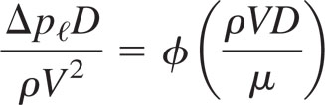
Back to Simple Example
Applying the Methodology outlined on the last slide (let’s do it on the board) we again obtain

Slide 10
By inspection
The recipe listed before will always work
Typically, we just do it by inspection
All these numbers can be thought of as ratios of forces, ratios of timescales, ratios of lengthscales….

Slide 11
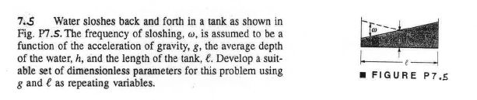
Sample Problem 1

Slide 12
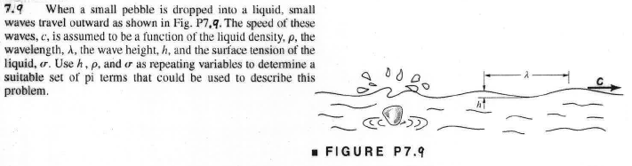
Sample Problem 2

Slide 13
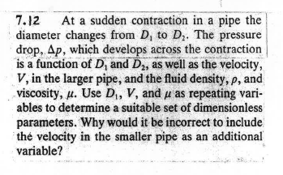
Sample Problem 3

Slide 14
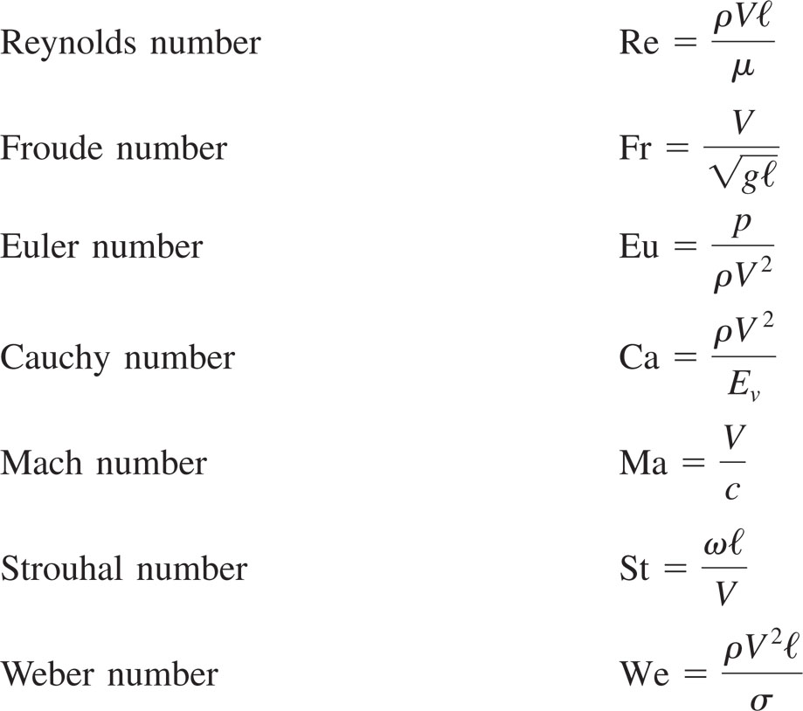
Common dimensionless Groups in Fluids

Slide 15
Some interesting examples
Hydraulic Jump
Drag on a Boat
Turbulent Flow in a Pipe
http://video.google.com/videoplay?docid=-5033243127531747249#

Slide 16
Data – Problems with One Pi Term
If only one term exists then according to the Pi Theorem we can say:
Π₁=C
Allows for a very nice relationship between variables and the constant can easily be fit from data….

Slide 17
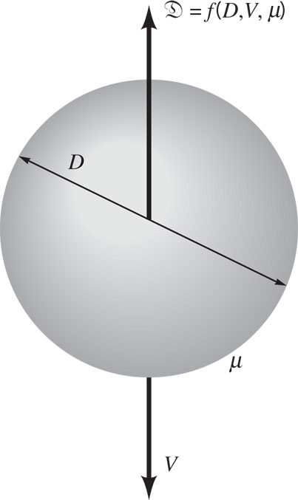
Classical Example (Very slowly falling spherical particle – what is drag)
Drag D = f (D,V,μ)
[D]= M L T⁻² [D]= L [V]= L T⁻¹ [μ]= M L⁻¹ T⁻¹
On one Pi group exists
Π₁=D/(μVD)=C
Or D= μ VDC
4 variables
3 dimension

Slide 18
Sample Problem
When a sphere of diameter d=5 mm falls at a velocity of 0.1 m/s in water
(viscosity=0.001 Ns/m²) it experiences a drag of 100 N.
Can you develop a general law for drag on a sphere of arbitrary size in
an arbitrary flow (for a slowing falling sphere)

Slide 19
Two of More Terms
For two terms Π₁=f(Π₂)
Π₁=f(Π₂)
Means when you have data you should plot Π1 against Π2 to deduce relationships or at least make best fits that can be used predicatively.

Slide 20
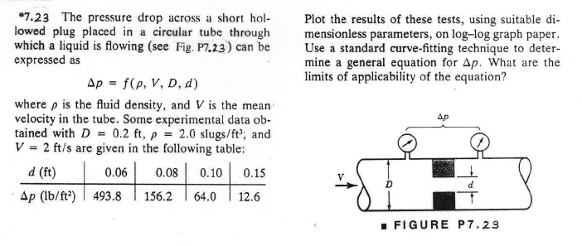
Sample Problem

Slide 21
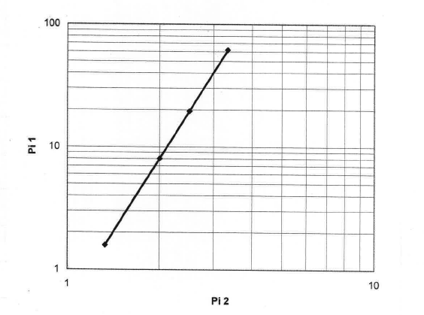

Slide 22
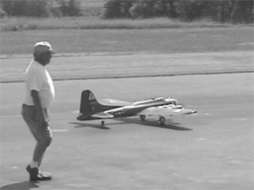
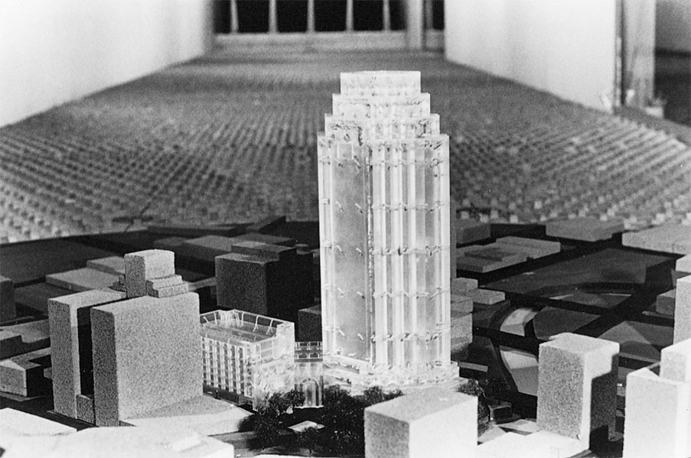
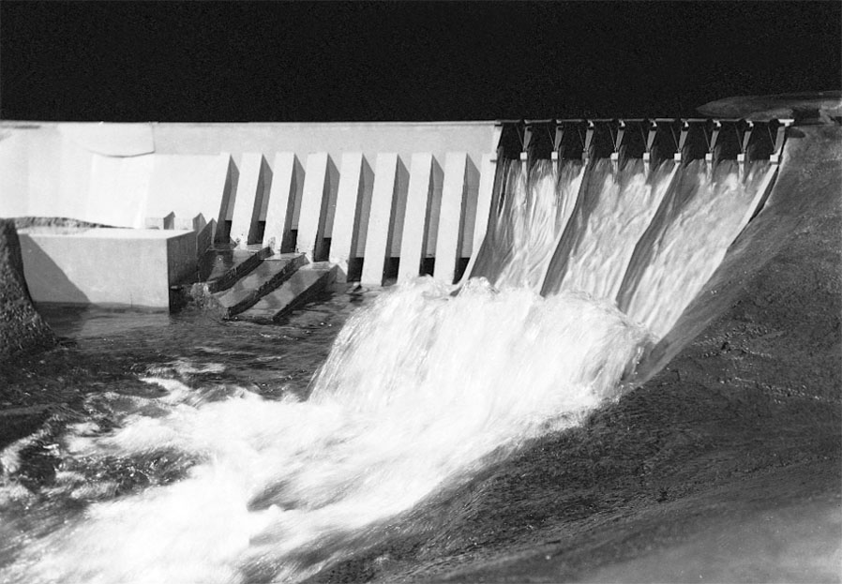
Modeling and Similitude
A model is a representation of a physical system that may be used to predict the behavior of the system in some desired respect, e.g.

Slide 23
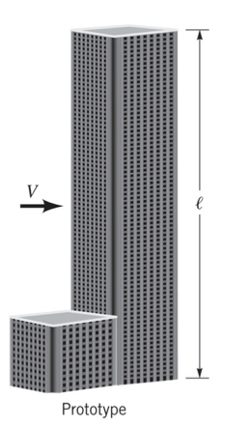
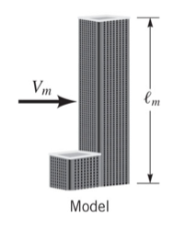
Is this enough?

Slide 24
Types of Similarity
Geometric (ratio of length scales the same)
Kinematic (velocity structures are the same)
Dynamic (ratio forces the same)
The best situation is: Get all dimensionless variables (Pi groups) the same between model and prototype. Then all similarities are preserved…..
Sometimes hard to achieve it all….

Slide 25
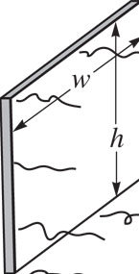

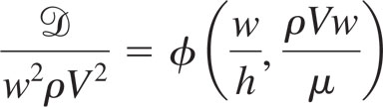
Example
Consider flow past some plate. You can to model drag
Pi theorem tells you
To ensure similarity w/h and ρVw/μ must be the same in model and prototype.
If this is true D/w²ρV² is the same in model and prototype

Slide 26
3 classical examples
Flow through Closed Conduits (Next Chapter)
Civil Engineering Applications
Flow around Immersed Bodies (e.g. Buildings)
Flow with a Free Surface (e.g. damns, hydroelectric)

Slide 27
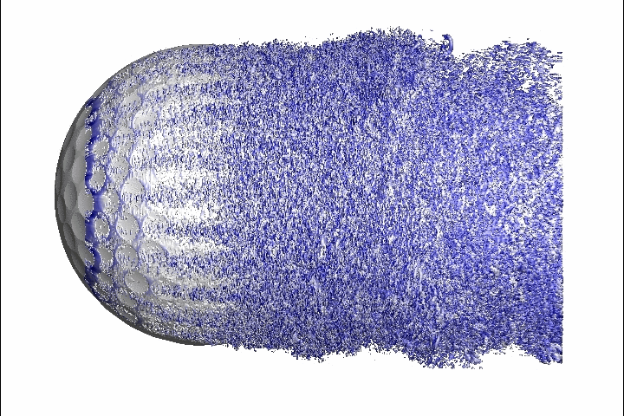
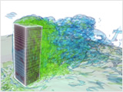
Flow around bodies
We are often interested in drag at high Reynolds number
Coefficient of drag
(what we want to measure in the lab)

Slide 28
Dimensionless Numbers
C_{D} – is dimensionless
Reynolds Number (ρ V l/μ)
Ratio of all length scales (l_{i}/l)
e.g. in golf ball depth of dimples over diameter of ball
In building width/height, window length/height, etc.
Using Pi Theorem
As long as the Reynolds numbers and
length scale ratios are the same in the
model as the actual case (prototype)
C_{D} will the same

Slide 29
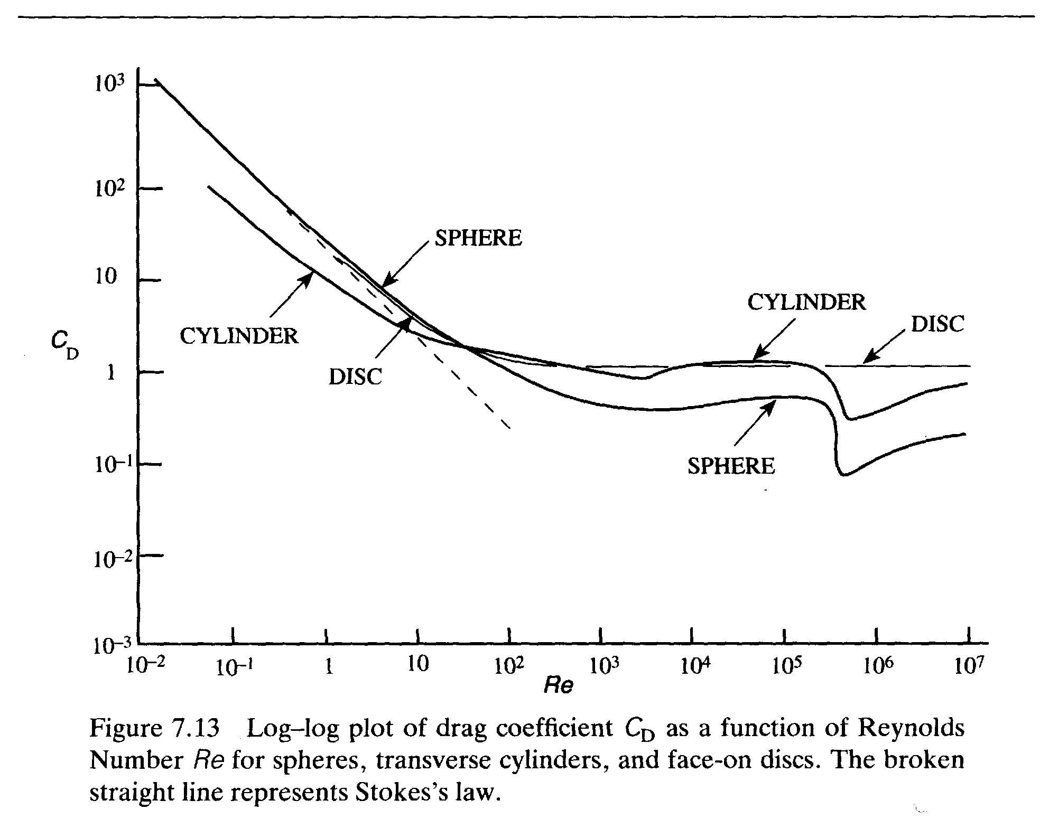
Relationship between Prototype and Model
We can now calculate the drag on the prototype from measurements on the model.

Slide 30
Flow with a Free Surface
Gravity Driven Flows (i.e. water flows down a hill)
As long as all other dimensionless numbers are matched between model and prototype Froude Number only matters (tough to do - e.g. Reynolds number – make large enough in both cases to not be important)

Slide 31
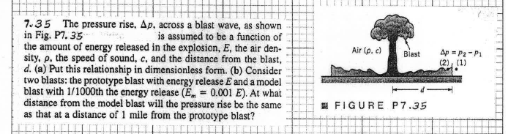

Slide 32
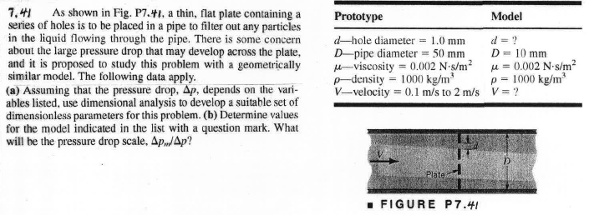
Sample Problems

Slide 33
Data – Problems with One Pi Term
If only one term exists then according to the Pi Theorem we can say:
Π₁=C
Allows for a very nice relationship between variables and the constant can easily be fit from data….

